Slide 1
Student: Tigran Budaghyan Professor: Manana Khachidze
TBILISI STATE UNIVERSITY
Faculty of Exact and Natural Sciences
“DATABASE NORMALIZER AND TUNER”
Tbilisi 2014

Slide 2
Main Relational Database Issues
Database Performance Issue
Anomalies, data redundancies, misconfigurations
Security Vulnerabilities
Complicated Management
How to proceed??

Slide 3
What am I suggesting?
By two words – Complex Database Analyzer
Facilitate the work of DBA’s
2 Parts – Normalizer (Data) and Tuner (Instance)
Detects…
Anomalies and redundancies
Security Vulnerabilities
Misconfigured system configurations, buffers and caches
Database Fragmentations
Indexes
Not changing nothing, but giving only recommendations and scripts to execute manually

Slide 4
How does it work?
Make a database connection
Read all tables column by column
Gives suggestions how to normalize in 2NF,3NF or BCNF (by choice)
Generates SQL Scripts for normalizing
Read database instance configurations from system tables, then database usages, in result gives recommendations
Lists all database users with permissions and warns if one of them does not have password assigned
Find index issues by looking in logs, warns if there are operations that performed without indexes
Find database fragmentations
Detects hardware configurations and warns if there are hardware lacks

Slide 5
Supported Database Systems
(for initial release)
MySQL
Oracle
MSSQL
MSACCESS

Slide 6
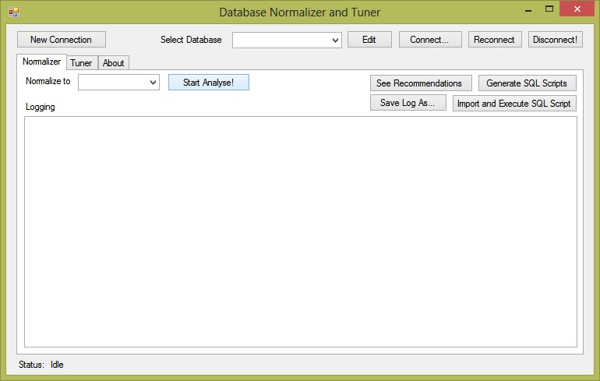
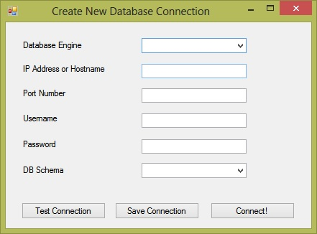
Application Interface

Slide 7
THANK YOU FOR YOUR ATTENTION!!

